Slide 1



Hospital Management System
A C++ Program

Slide 2

TABLE OF CONTENTS
01
02
DEFINING THE PROBLEM
DEVELOPMENT
It includes statement, project basis, any general remarks
It summarizes the project objectives
04
06
CONCLUSIONS
REFERENCES
What conclusions were drawn from the project;
bibliographies (lists of sources on specific topics)

Slide 3
DEFINING THE PROBLEM
01
Hospital Management System in C++

Slide 4
SUBSECTIONS
Chapter I -Subsections
1.1 Description of the theme | It includes statement, project basis, any general remarks.
1.2 Description of requirements | It includes description of the theme, project basis, constraints, algorithms, results, any general remarks.
1.3 Functional Specifications | It specifies the functional requirements of the program. It presents all functional requirements of the program, relationships between them and their links with other requirements.
1.4 User Interface | It presents requirements for user interface (will be focused on a simple menu; it presents the proposed dialogue with the user for all menus, submenus, etc.)

Slide 5


1.1 Description of the theme
Hospital management system is a computer system that helps manage the information related to health care and aids in the job completion of health care providers effectively.
They manage the data related to all departments of healthcare such as clinical, financial, laboratory.

Slide 6
ADVANTAGES
EFFICIENCY.
TIME.
Improved Efficiency by avoiding human errors.
Time-saving Technology.

Slide 7
1.3 Description of requirements
CLASSES
FUNCTIONS
LINES OF CODE
9 Classes.
20 Functions.
Over 2800 lines of code

Slide 8
Patients Management
Doctors Management
In this section, patients can enter their personal information, things like their id, name, address, phone number, etc.
These are saved in a file (database.txt), which can be accessed in the project folder.
In this section, doctors can enter their personal information, things like their id, name, address, phone number, salary, etc.
These are saved in a file (database2.txt), which can be accessed in the project folder.

Slide 9
Beds Management
Appointments
In this section, users can reserve a bed suitable for their medical needs. They just need to choose the convenient one and the app will calculate the cost in the billing zone.
Here, you can see all the sections that exist in this HMS and users can make an appointment for a consultation with the specialist that lead the section. The cost is also calculate in the billing section
These are saved in a file (receipt.txt), which can be accessed in the project folder.
These costs are saved in a file (receipt.txt), which can be accessed in the project folder.

Slide 10
Charges&Bills
Waiting List
In this section, users can notice their beds&appointments total price to see if it fits the budget.
These are saved in a file (receipt.txt), which is available in the project folder.
Only doctors / operators are allowed in this section. Here, patient data can be entered and, with the help of lists, a waiting line is created.
You need a password when you enter this section.

Slide 11
Help
Exit
This Function end the program.
When the help command is called, users will be given the information they need to use the system.

Slide 12
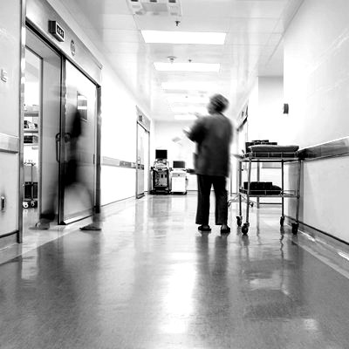
1.4. User Interface
A main menu
A submenu

Slide 13
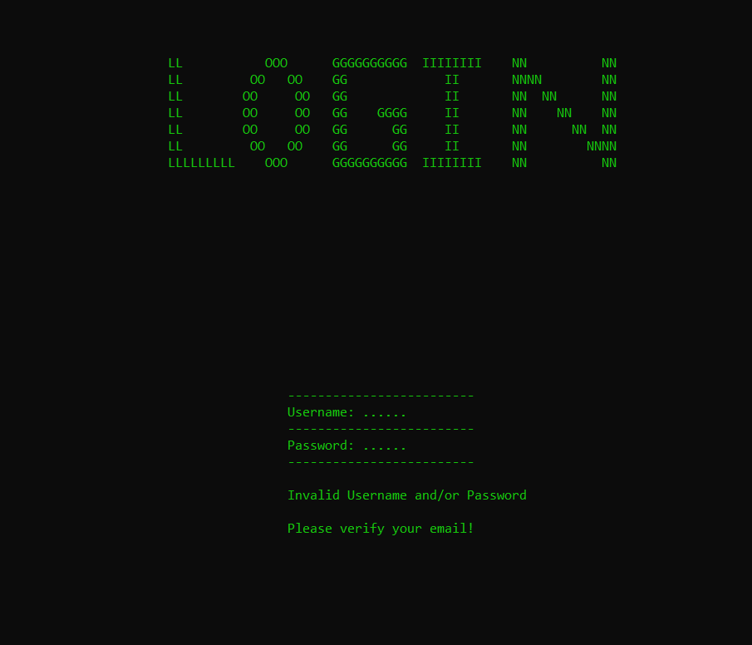
In order to enter the main menu, users need a username and password (see e-mail).

Slide 14
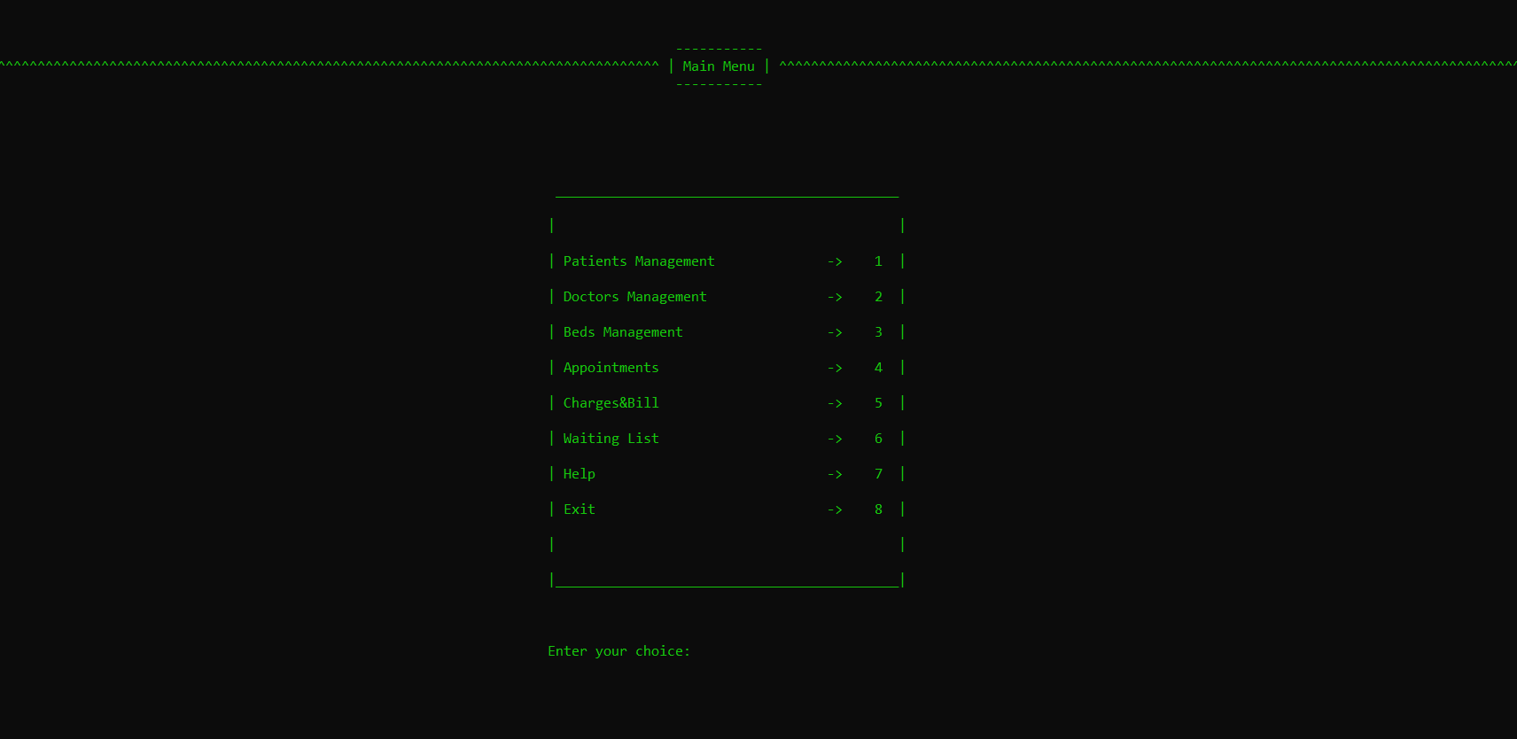
Main Menu

Slide 15
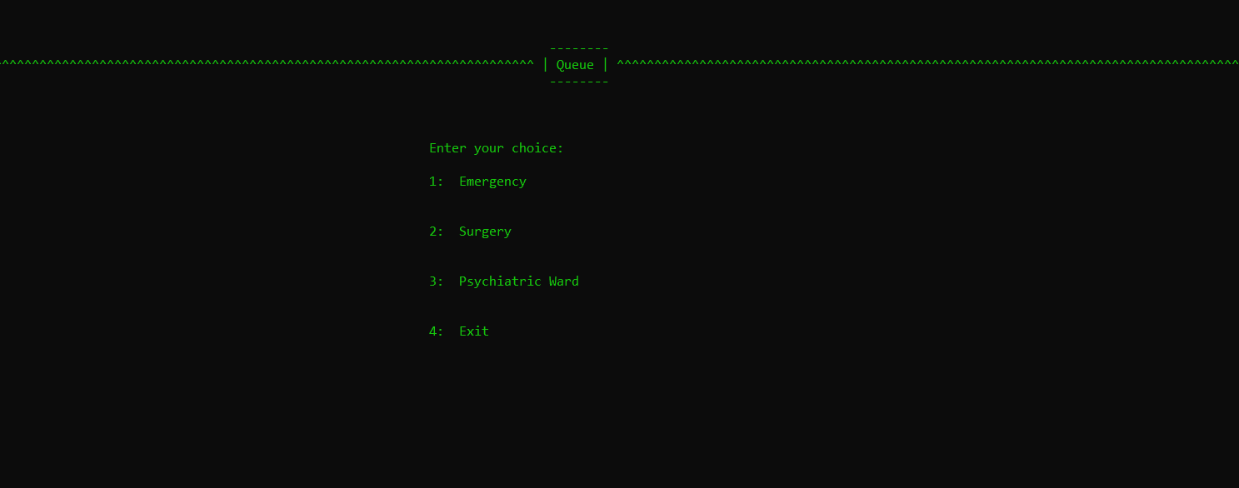
Submenu

Slide 16
Project Development
02
Hospital Management System in C++

Slide 17
SUBSECTIONS
Chapter II -Subsections
2.1 General objectives | It summarizes the project objectives.
2.2 Description of data processed by the program | Description of input and output data and used formats (data structures/classes).
2.3 Description of program modules | Functions, parameters, returned values, algorithms used, etc…
1.4 User Interface | It presents requirements for user interface (will be focused on a simple menu; it presents the proposed dialogue with the user for all menus, submenus, etc.)

Slide 18

2.1 General Objectives
Hospital management system is a computer system that helps manage the information related to health care and aids in the job completion of health care providers effectively.
They manage the data related to all departments of healthcare such as clinical, financial, laboratory.

Slide 19
Objectives
-> Maintain the medical records of the patient.
-> Maintain the medical records of the doctors.
-> Maintain the contact details of the patient.
-> Keep track of the wanted appointment.
-> Tracking the bill payments.
-> Keep track of the beds that are used the most.

Slide 20
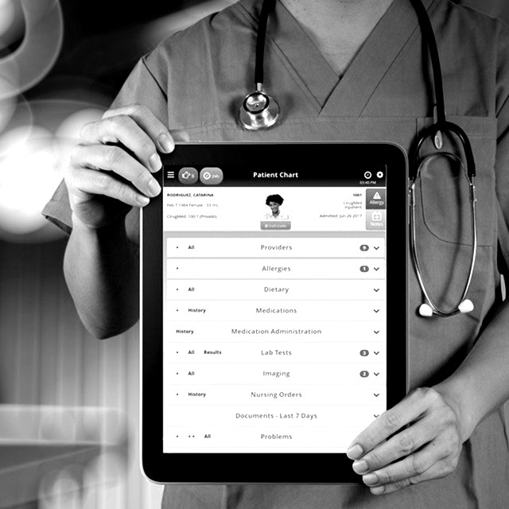
2.2. Description of data processed by the program
Description of input and output data and used formats (data structures/classes)

Slide 21
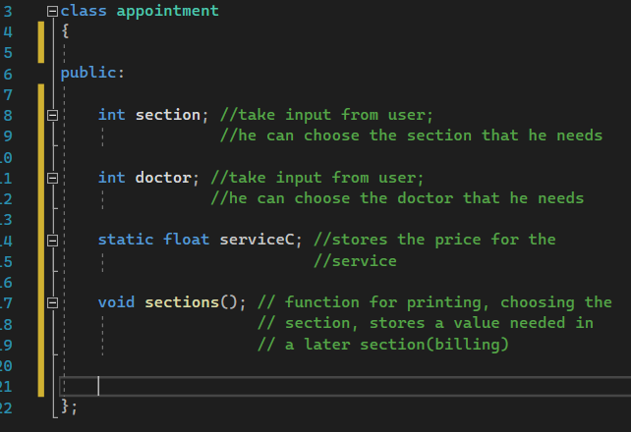
Appointment Class
This class is created specifically for appointments in a particular specialty.
Patients can see their doctors, prices, and work schedule.

Slide 22
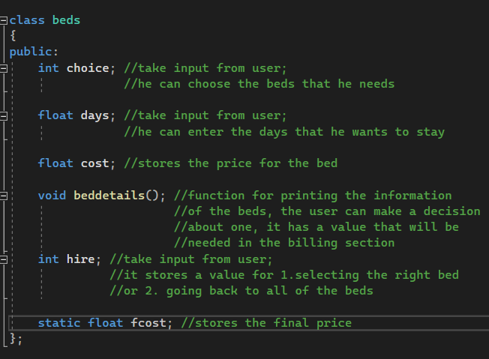
Beds Class
The "Beds" class is intended for choosing a bed adapted to the patient's needs.
In this class are found the information needed to make this choice.

Slide 23
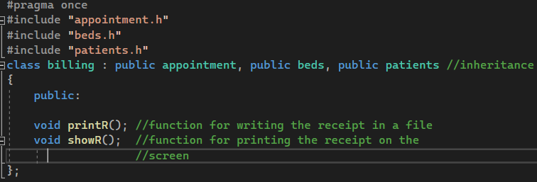
Billing Class
The mission of the "Billing" class is to calculate the costs of all money-making choices made by users.
Finally, the costs can be viewed in a file along with the user ID.

Slide 24
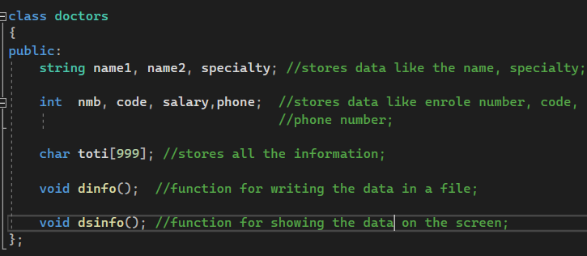
Doctors Class
In this class, doctors can store their personal information. It can be found in a file.
The data is used for verification.

Slide 25
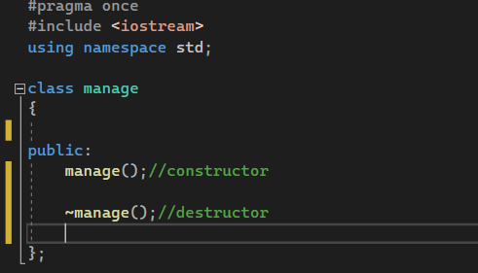
Manage Class
In the "Manage" class there is only the login and the menu that includes the whole program.
Only with this class was created a main object that runs the entire application.

Slide 26
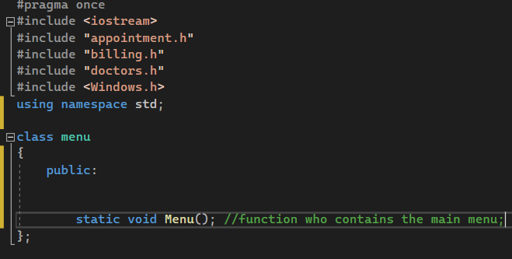
Menu Class
This class contains the function with the main menu, all objects are created here.

Slide 27
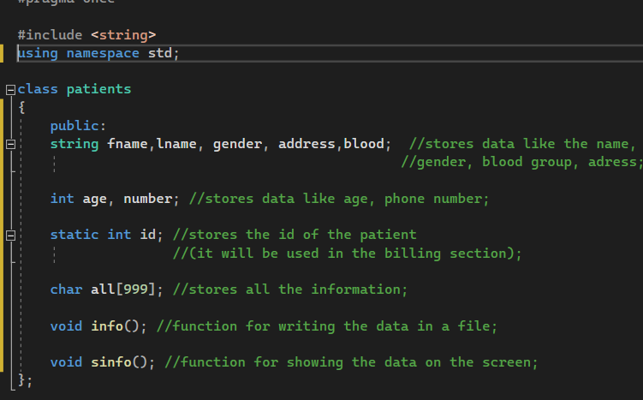
Patients Class
In this class, patients can store their personal information. It can be found in a file.
The data are used for identificational purposes.

Slide 28
Queue Class
With the help of this class, a list of patients is created. Thus, their needs are classified into 2 types: urgent and non-urgent.
Patients can be removed from this list.

Slide 29
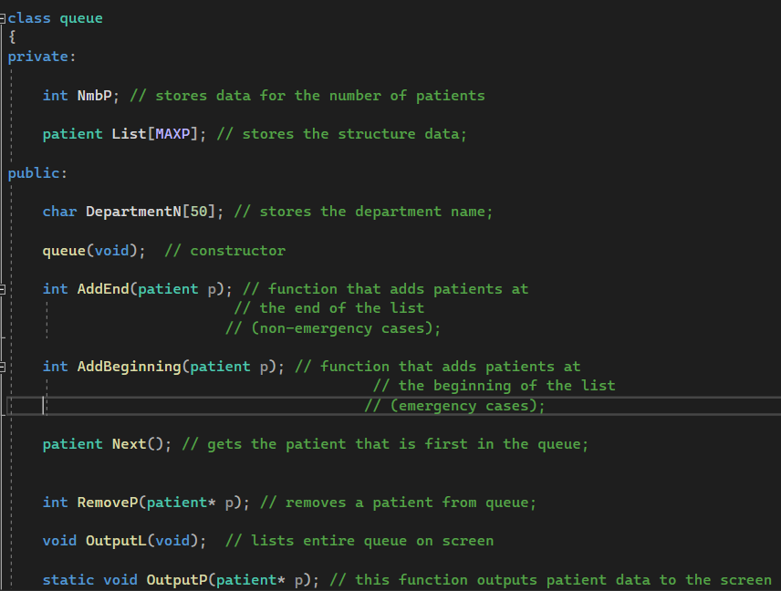
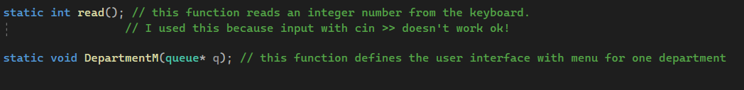

Slide 30
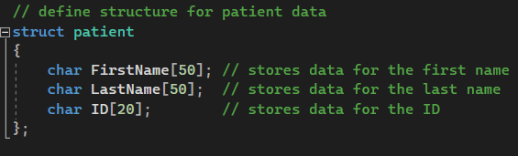
Patient Structure
This structure is used to hold information about the patient's name and id.

Slide 31
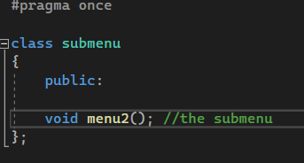
Submenu Class
This class contains the function with the submenu.
It has the waiting list section in it.

Slide 32

2.3 Description of program modules
Functions, parameters, returned values, algorithms used, etc..

Slide 33
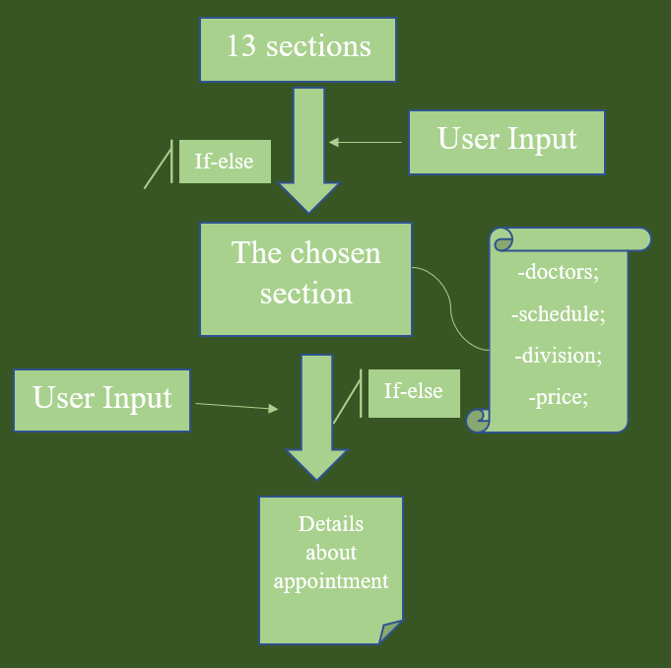
void sections();
How it works?
Appointment Class

Slide 34
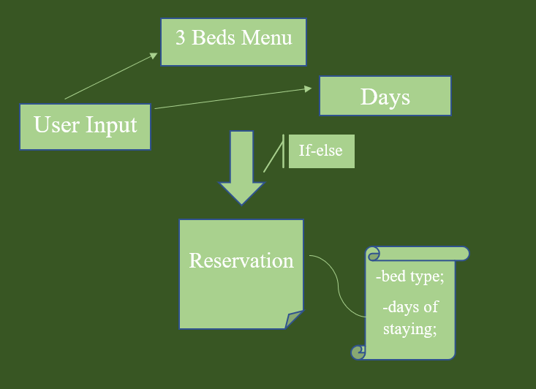
void beddetails();
How it works?
Beds Class

Slide 35
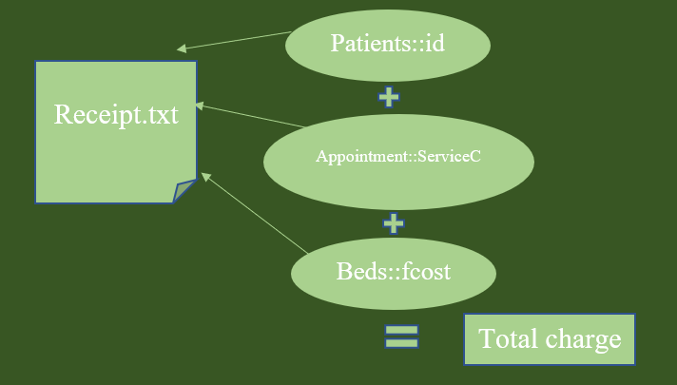
void printR();
How it works?
Billing Class

Slide 36
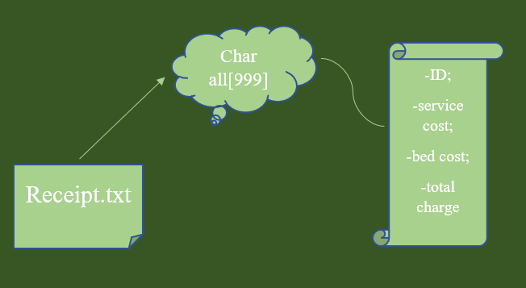
void showR();
How it works?
Billing Class

Slide 37
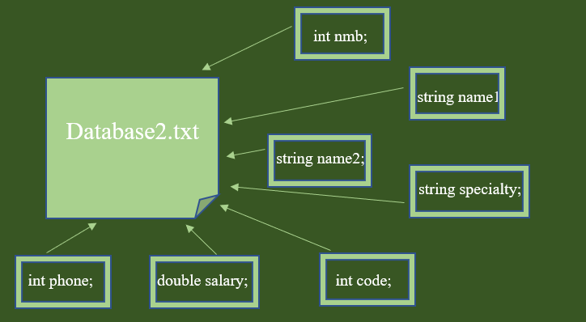
void dinfo();
How it works?
Doctors Class

Slide 38
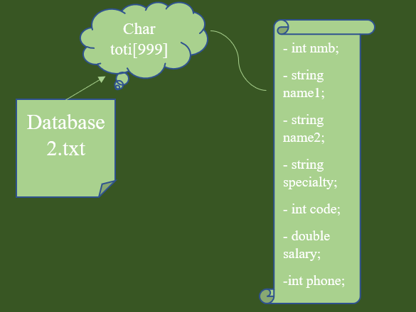
void dsinfo();
How it works?
Doctors Class

Slide 39
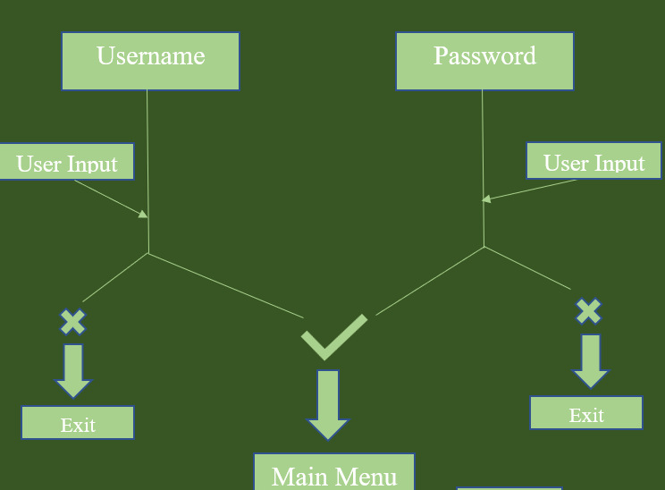
manage;
How it works?
Manage Class

Slide 40
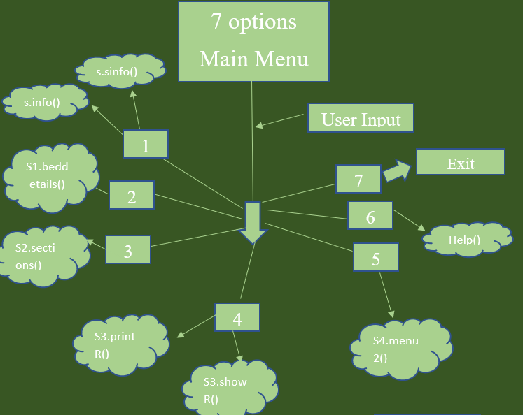
Static void Menu();
How it works?
Menu Class

Slide 41
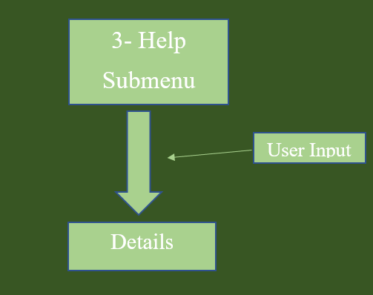
void Help();
How it works?
Menu Class

Slide 42
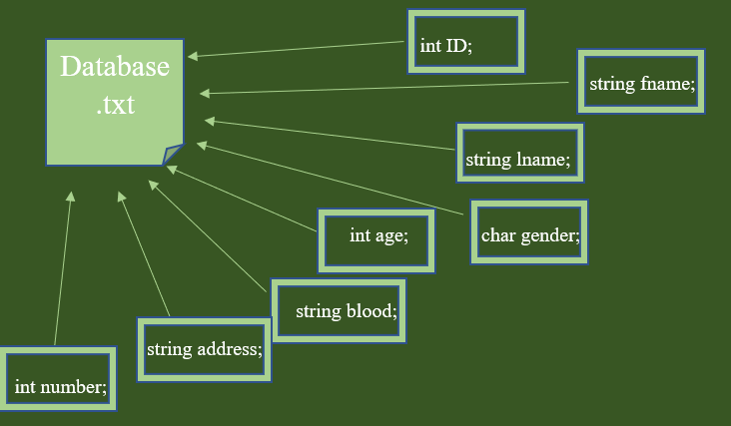
void info();
How it works?
Patients Class

Slide 43
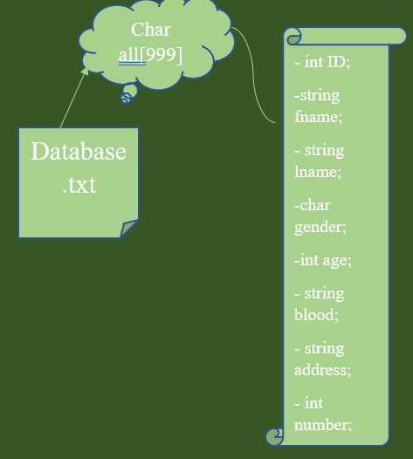
void info();
How it works?
Patients Class

Slide 44
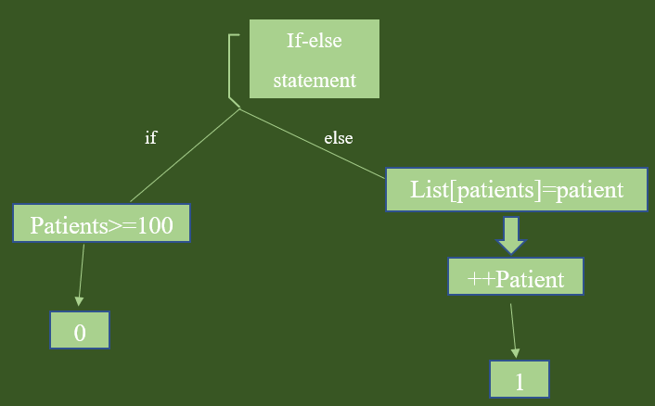
int AddEnd(patient p);
How it works?
Queue Class

Slide 45
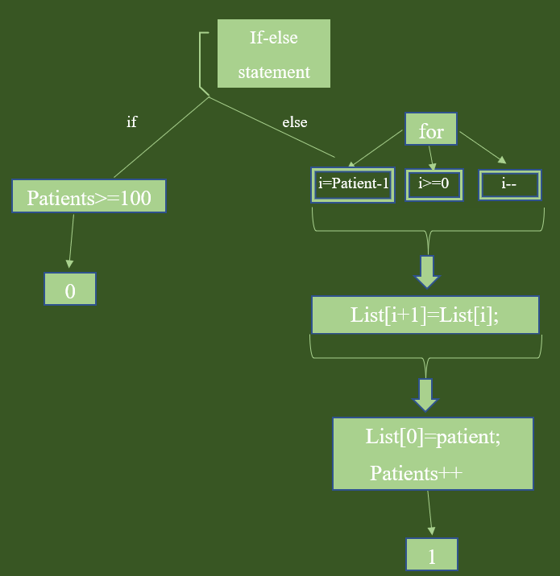
int Add Beginning(…);
How it works?
Queue Class

Slide 46
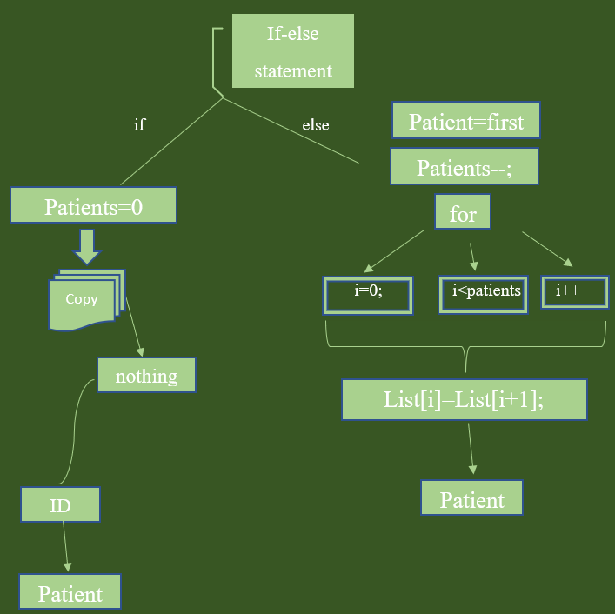
Patient Next();
How it works?
Queue Class

Slide 47
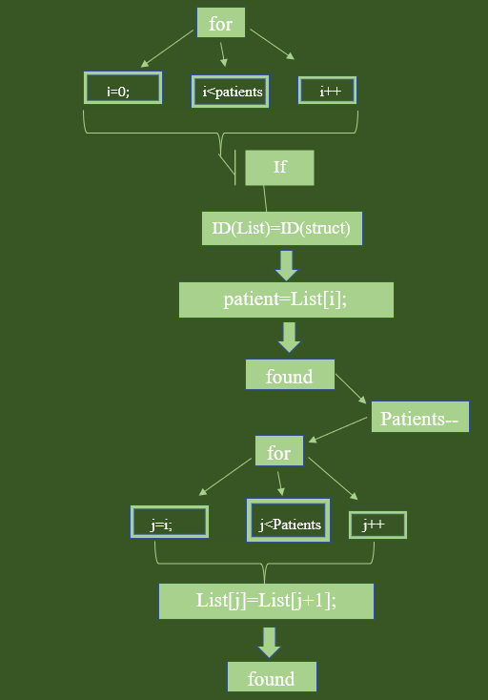
int RemoveP(patient* p);
How it works?
Queue Class

Slide 48
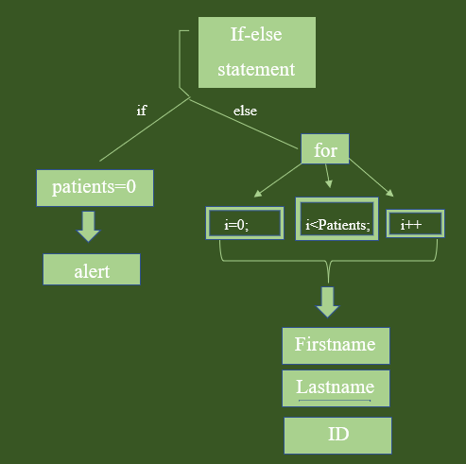
void OutputL();
How it works?
Queue Class

Slide 49
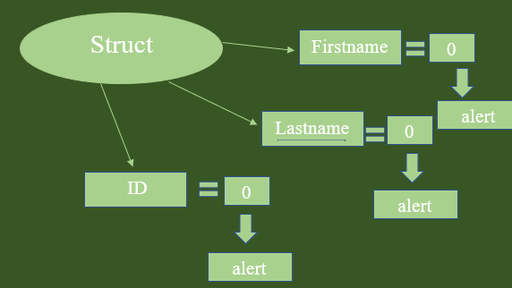
Patient InputPatient();
How it works?
Queue Class

Slide 50
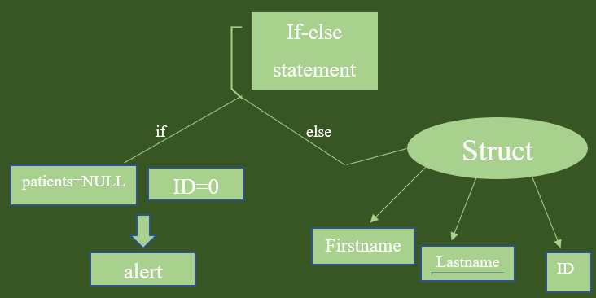
void OutputP(patient*p)
How it works?
Queue Class

Slide 51
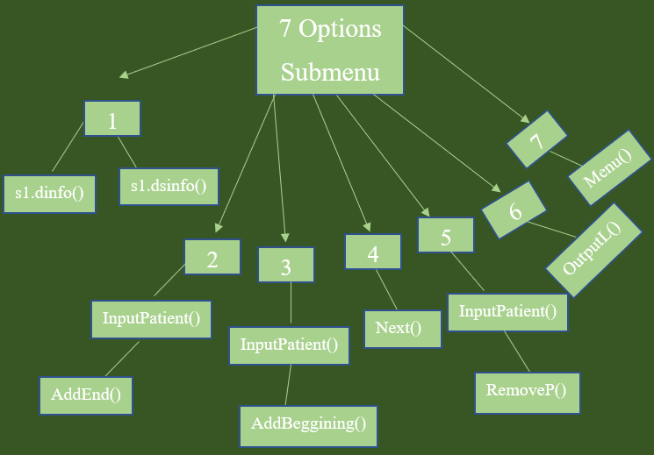
void DepartmentM(queue*q);
How it works?
Queue Class

Slide 52
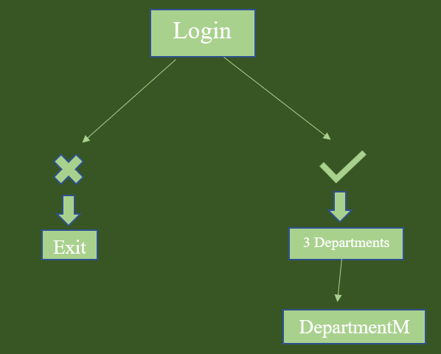
void menu2();
How it works?
Submenu Class

Slide 53
Conclusions
03
Hospital Management System in C++

Slide 54
Conclusions
The realization of the project was not exactly easy, it takes a lot of work and continuous attention.
In the future, I would like to devote more time to develop such a project.

Slide 55

In the Future
ALGORITHMS
50%
RESEARCH
40%
Design
10%

Slide 56
References
04
Hospital Management System in C++

Slide 57
References
http://www.lmpt.univ-tours.fr/~volkov/C++.pdf
https://github.com
https://slidesgo.com/technology
https://www.cplusplus.com
https://www.youtube.com
https://www.geeksforgeeks.org

Slide 58
THANKS!
University Transilvania
Faculty of Electrical Engineering and Computer Science
Electrical Engineering and Computers
Brezuică Andreea-Alexandra
4LF511 Group
Freshman Year
The 26th May 2022

